Slide 1
EC2 Deployment
Jacob Johnson
jmjohnson63660@gmail.com

Slide 2
What I am going to do?
Sign into the AWS console
Launch an EC2 Linux Instance
Configure Apache to make a simple website
View my website

Slide 3
What is EC2?
EC2 stands for Elastic Compute Cloud
Think of EC2 as a way to make your on virtual machines hosted on AWS

Slide 4
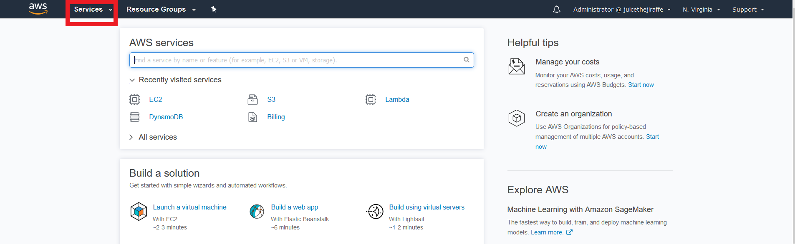
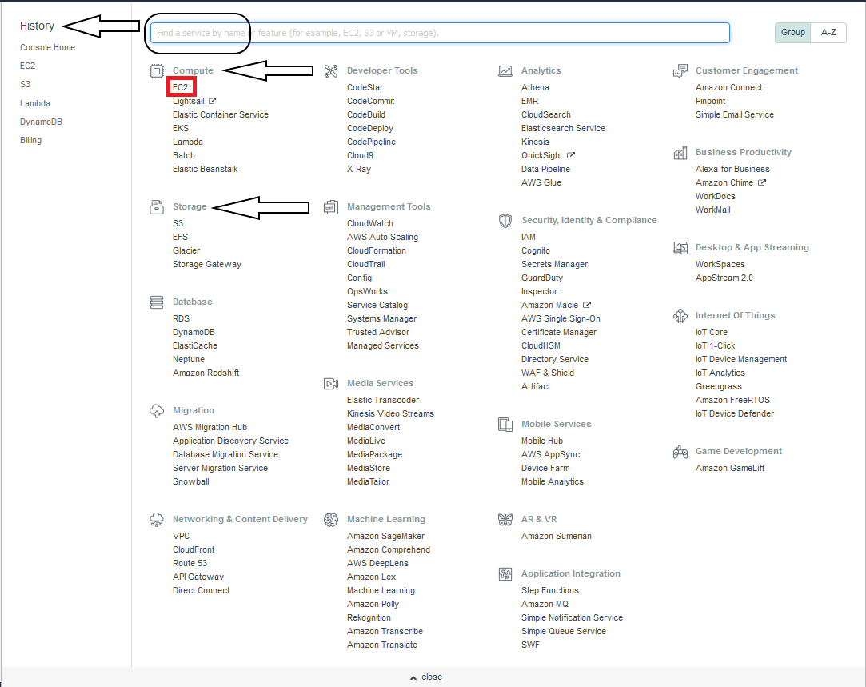
AWS Console
The initial sign in will look like this top picture
Click the services tab highlighted in red
Services are broken up into groups and each group has AWS services that correspond to that group
This can be overwhelming trying to find what specific service you are looking for
To help this you have a history tab to the left
You have a find a service tab outlined by the box
We will click on EC2 highlighted in red
EC2 stand for elastic compute cloud and this is used to launch your own virtually machines in AWS called Instances

Slide 5
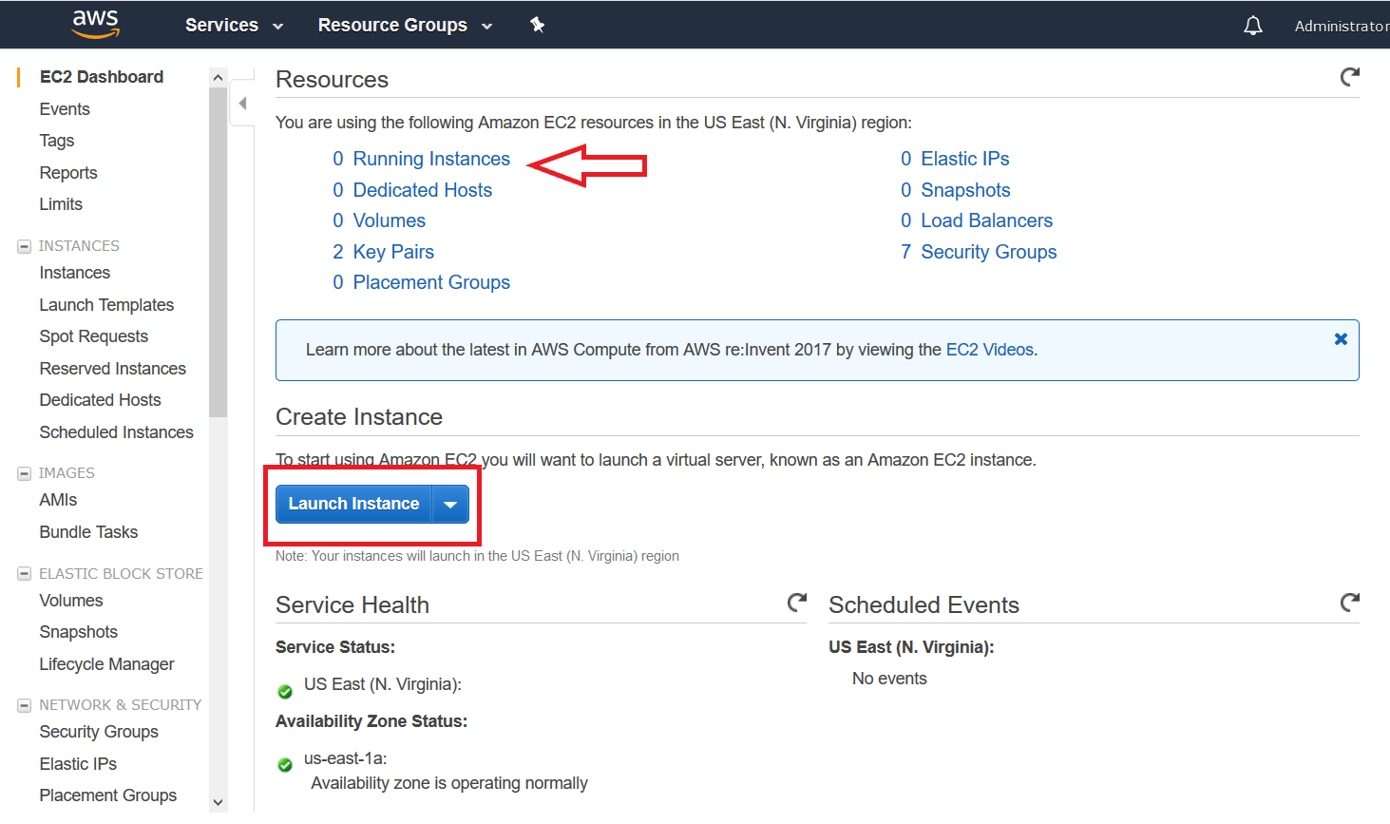
Create an EC2 Instance
Clicking EC2 will bring you this splash screen
At this screen you can see different resources you may have on your AWS account
The arrow is pointing at running instances which currently is at 0
By the end of this presentation that will change to 1
Click on the Launch Instance box represented by the box
This will send you a 7 step process you take when launching Instances

Slide 6
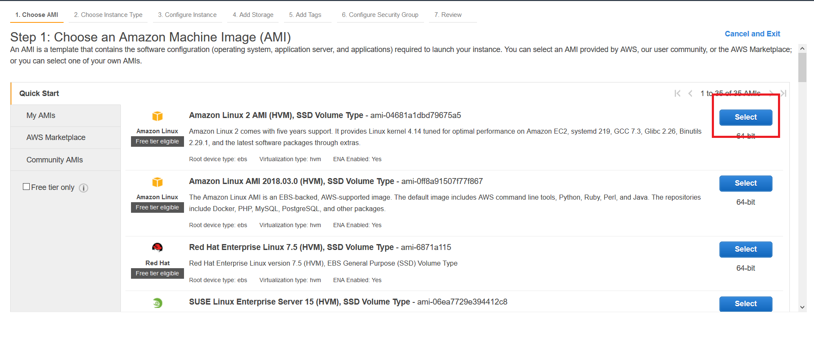
EC2 Wizard Step 1
The first thing you need to do is select the AMI you want with this Instance
AMI stands for Amazon Machine Image which defines the Instances operating system you are going to use
For this we will use Amazon Linux 2 AMI, but you can use different types of Linux AMI’s and Windows AMI’s for launching Instances
Click Select on the AMI you want to continue to step 2

Slide 7
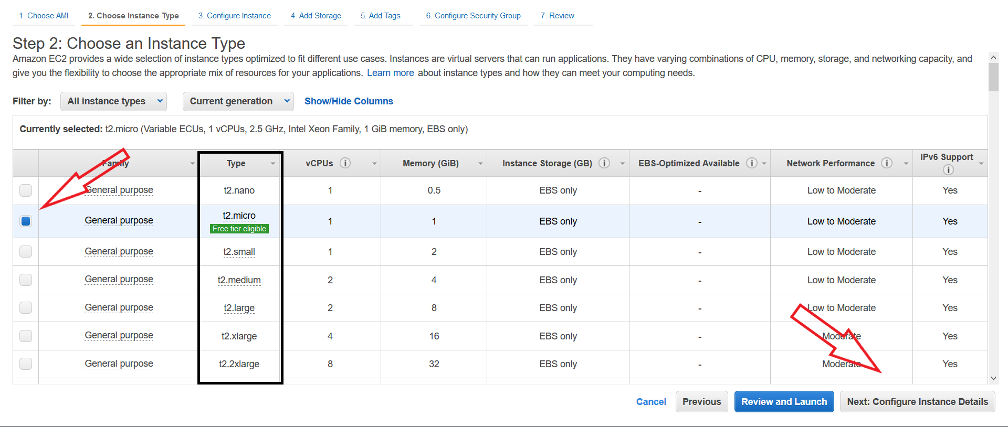
EC2 Wizard Step 2
Next you need to choose an Instance Type
Instance Types specify how much CPU and RAM you will have in your Instance
There are many different Instance types, but for this we will use a t2.micro as that will cost the least
Make sure the instance type you want has the blue box and click Next Configure Instance Details

Slide 8
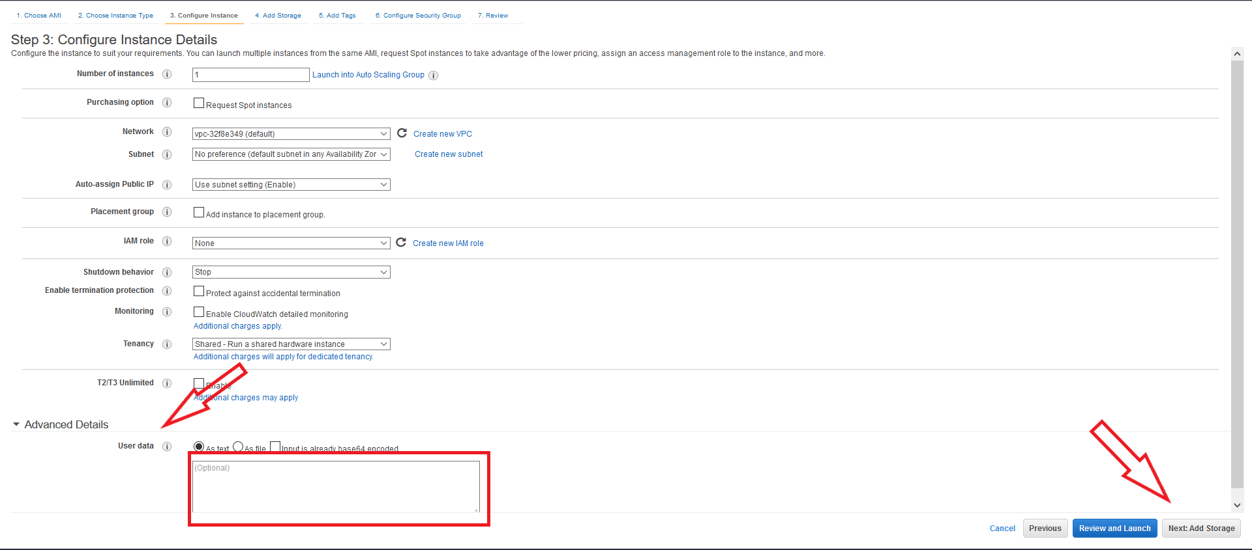
EC2 Wizard Step 3
Now we can configure Instance Details
We are going to leave everything default
To continue we will click Next Add Storage

Slide 9
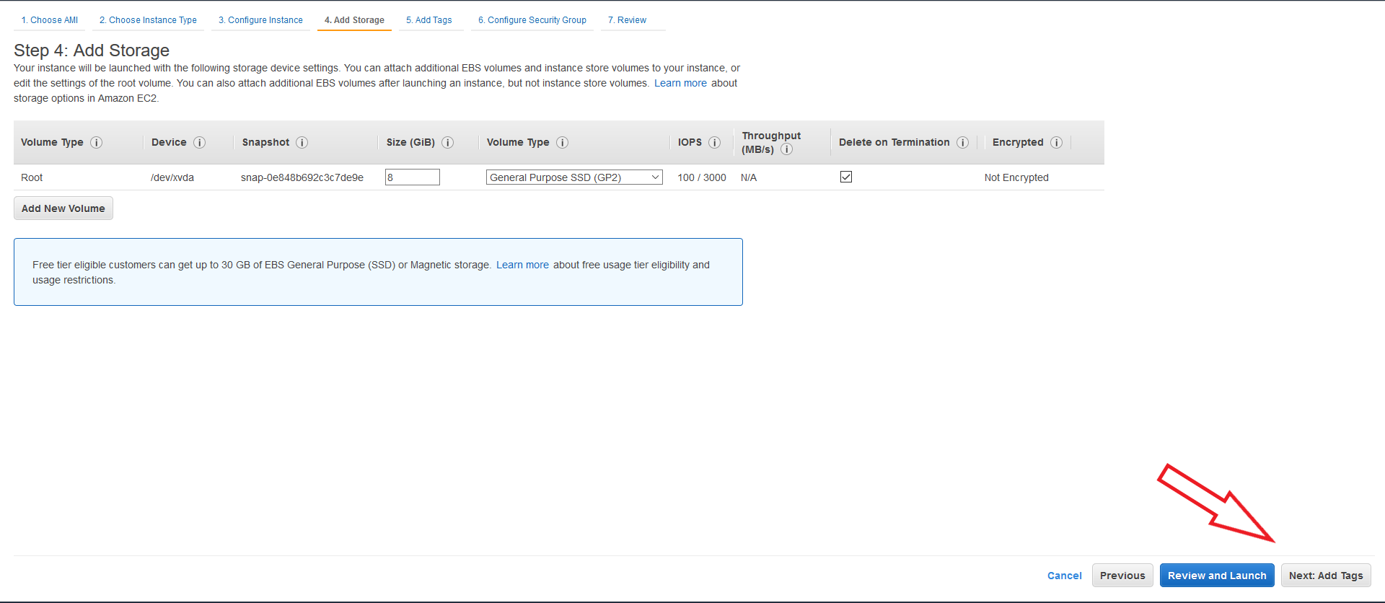
EC2 Wizard Step 4
For today you do not need to know anything about this page
We will quickly click next to add tags

Slide 10
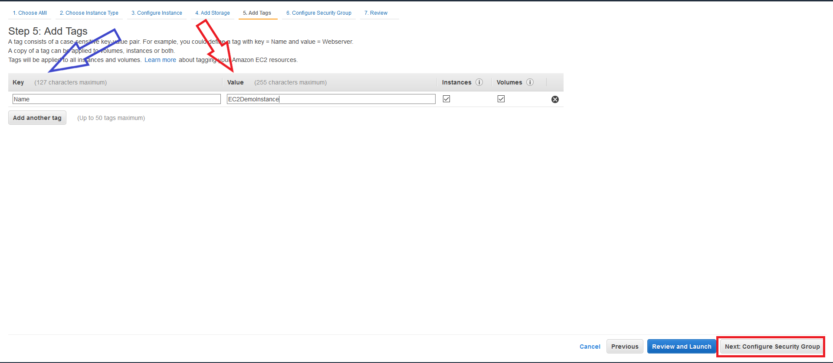
EC2 Wizard Step 5
Tags are a way to identify your EC2 instances apart
Tags are key value pairs and we will be using Name for the key and EC2DemoInstance for the value
Tags are really important in the real world if you have hundreds of Instances and you need to find a specific one
Click Next Configure Security Groups

Slide 11
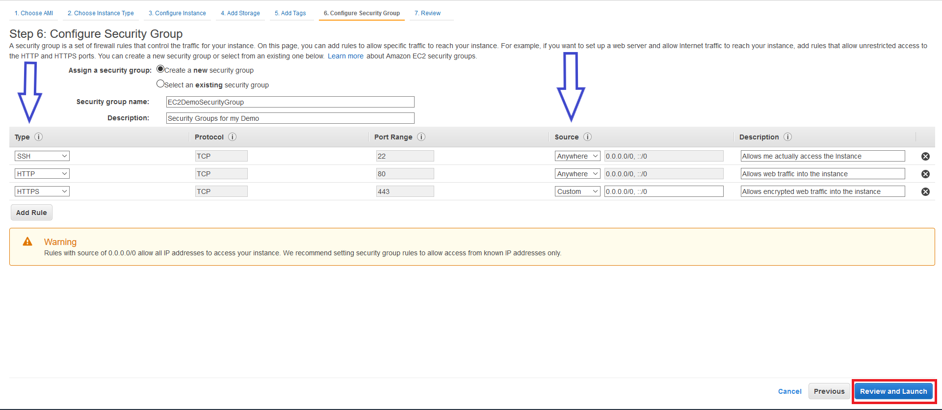
EC2 Wizard Step 6
Security Groups are stateful firewalls attached to your Instances
Stateful means if something is allowed in to your Instance then that same traffic is automatically allowed out
For this we are going to set up 3 types of rules SSH, HTTP, and HTTPS
We also need to define the source from where this traffic is allowed
I am going to allow the traffic from anywhere
Click Review and Launch to move on
SSH stands for Secure Socket Shell. This protocol is used to securely access a remote computer. If we do not have this open we could not access are Instance directly.
HTTP is the protocol used for web traffic. We need this open in order to allow our website to be viewed from the internet.

Slide 12
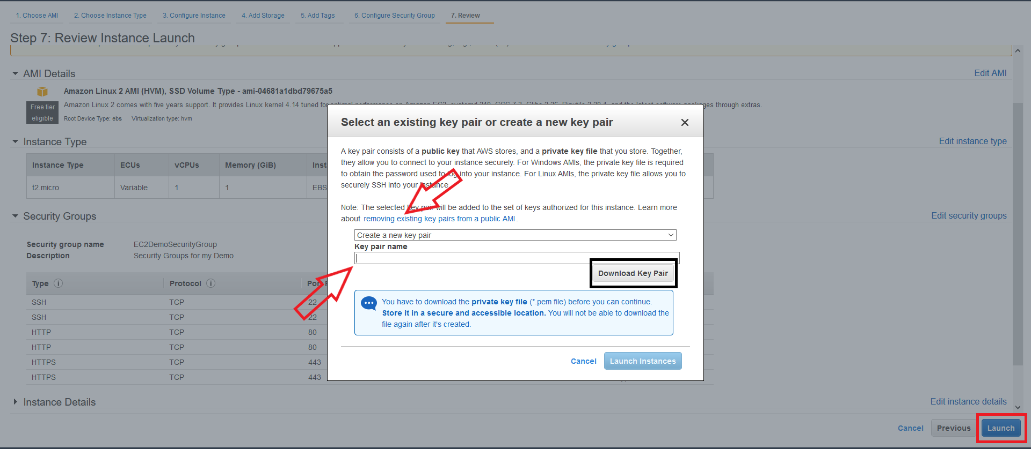
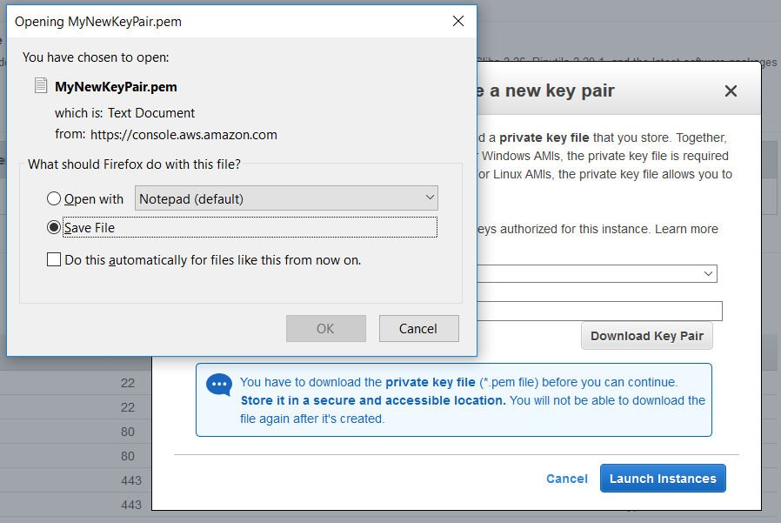
EC2 Wizard Step 7
The background of these pictures will
be the review page
We will need to click launch and it will
ask for a key pair
I will be choosing to create a new key
pair
We must first give the key pair a name and then click Download Key Pair
Then we will get a pop up like in the bottom picture and we will save the file in our downloads folder
Then the Launch Instances button will become available and we will click it to finish the instance creation

Slide 13
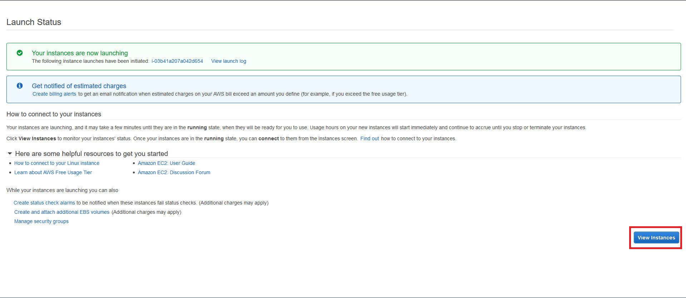
A screen like so will appear stating that your instance is getting created. We will click view Instances as we will need some information from there in order to login to the Instance.

Slide 14
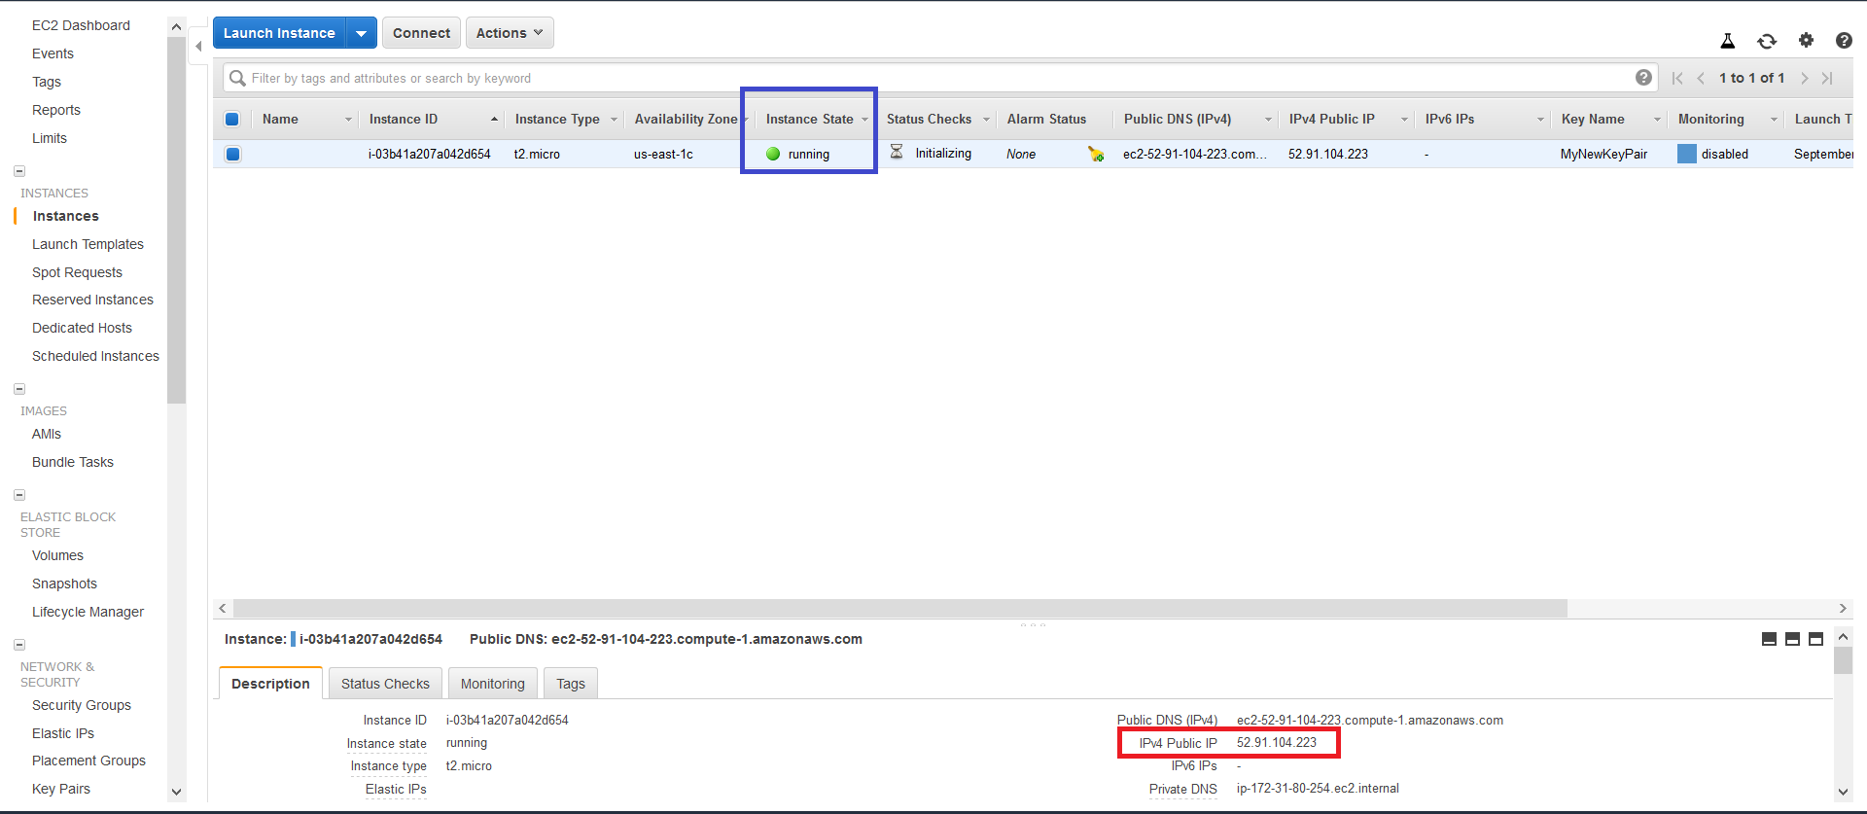
EC2 Screen
The EC2 screen is a good place to look at all of your Instances in your account.
In order to SSH into your Instance you need to make sure the Instance is running, you need to copy the IPv4 Public IP, and you need a PPK version of your Key Pair.
PPK stands for Putty Private Key file and you need to manual change your normal key pair into a PPK. You need to use Putty which is a free open source terminal emulator.

Slide 15
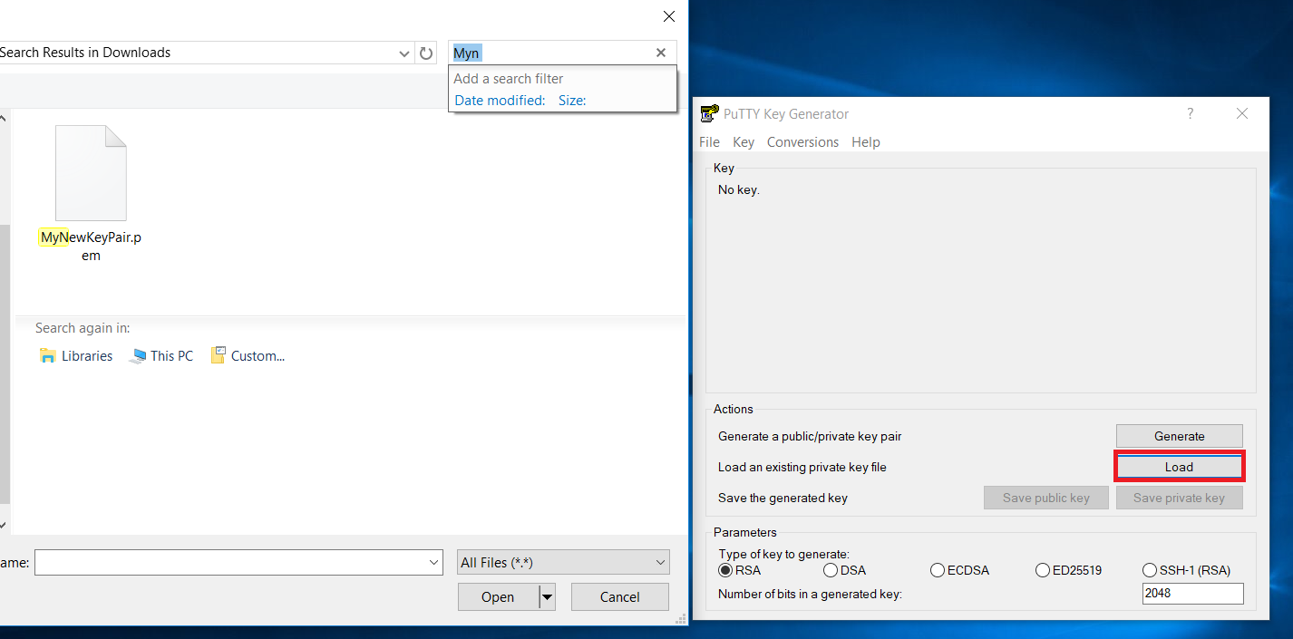
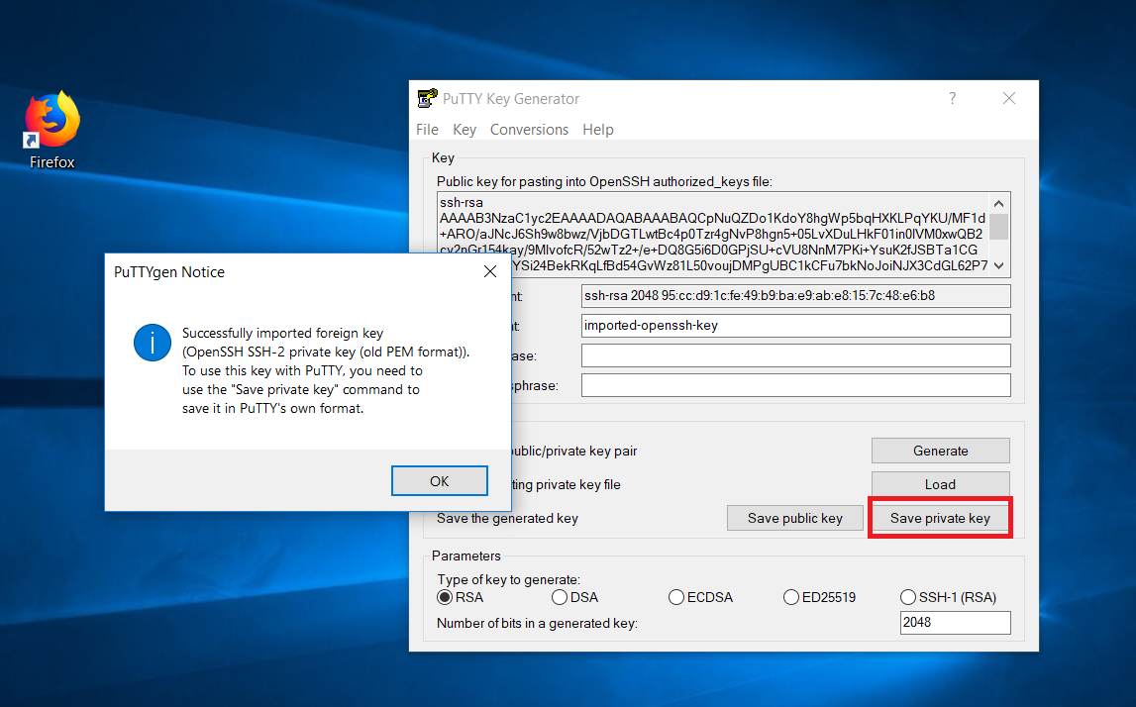
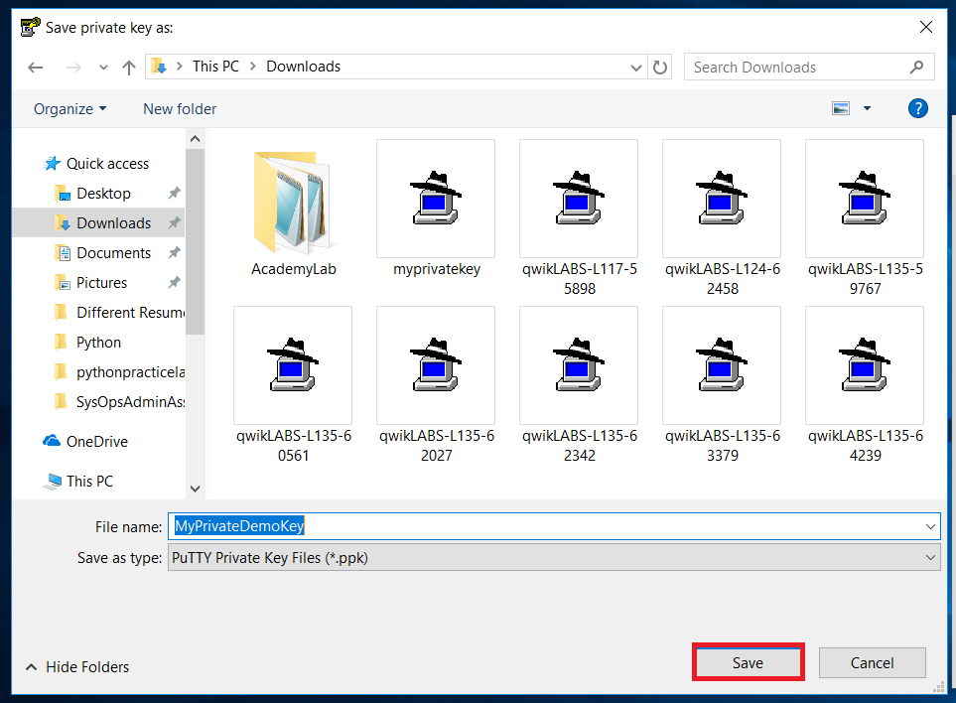
Creating A PPK
First to change the public key pair into a PPK you need Putty Key Generator which is an extension of Putty
The Putty Key Generator box will open and you need to click on Load
We will first locate the newly made Key Pair associated with our Linux Instance and open it
Next we will click Save Private Key as shown in the picture below

Slide 16
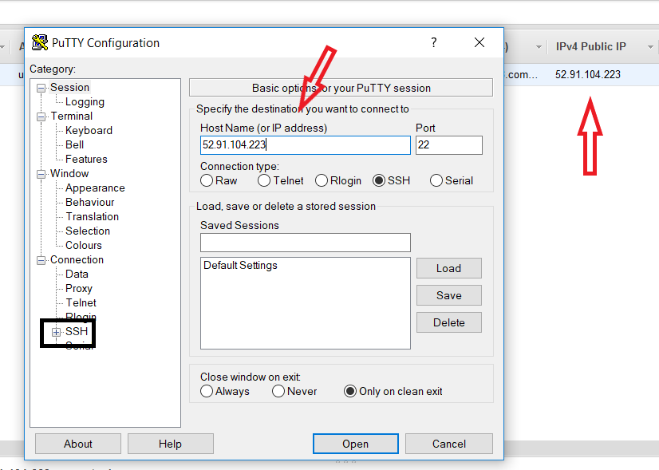
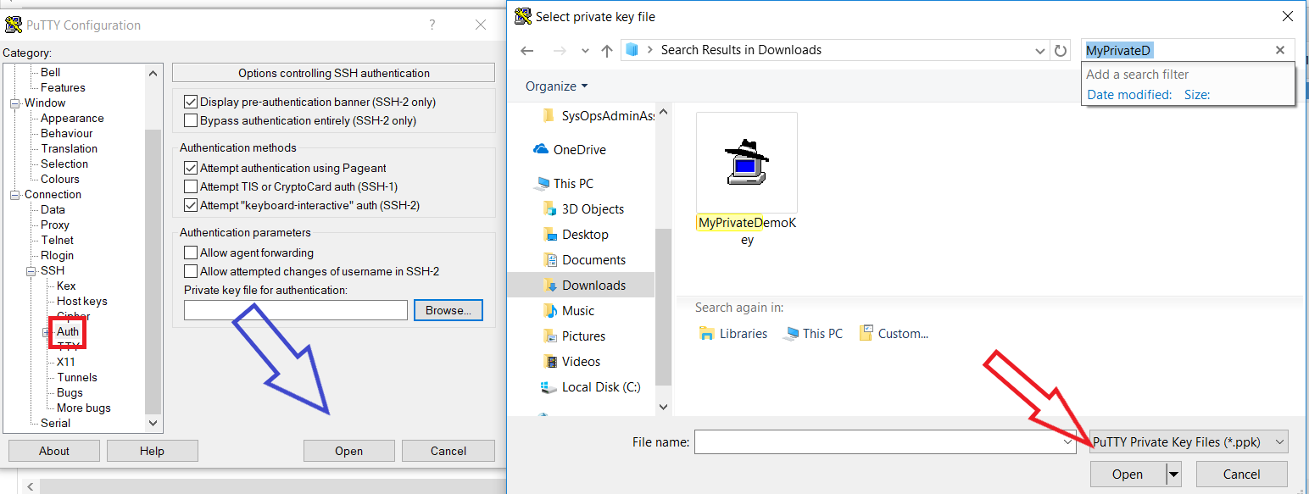
SSH In
First we will open up regular Putty instead of the Putty Key Generator
We will copy and paste the IP Address associated with the Instance you are going to use
After that we will locate the SSH option on the left side of the screen boxed in black
We will click on the plus sign to give us more options and we will click on the Auth button shown in the second picture
Click on the browse button and locate the PPK file we just made
Click open on the file and then open on putty where the blue arrow is

Slide 17
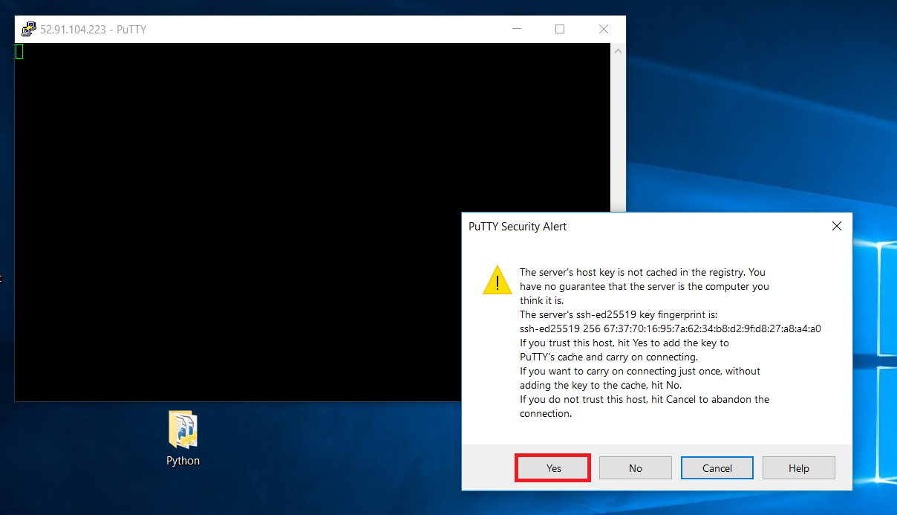
SSH In Continued
Putty will then bring up a black box and a security alert message
Click Yes to allow access

Slide 18
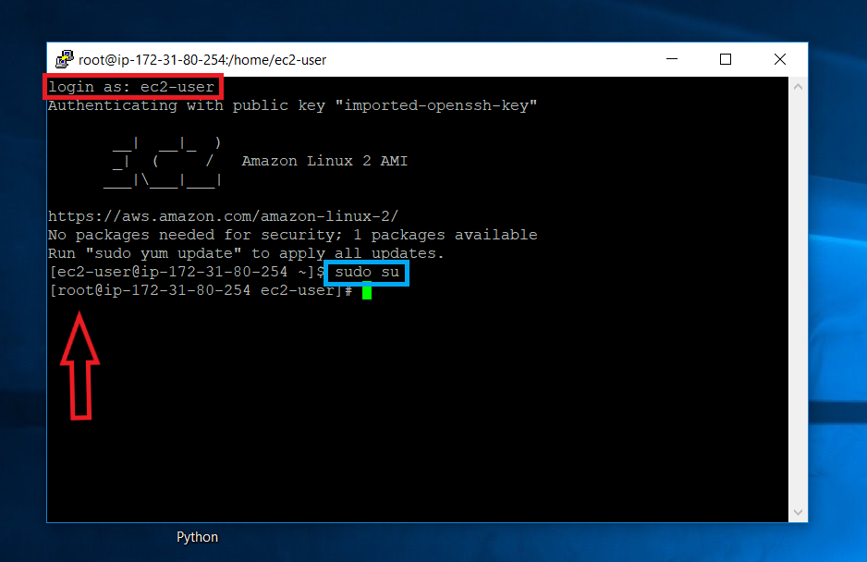
Making A Website
After you click yes you will be prompted with a login as: type ec2-user and press enter
The first command we will do shown in blue is the sudo su command
This command changes me from a user to a root user
What that means is I will have administrator access with this Instance

Slide 19
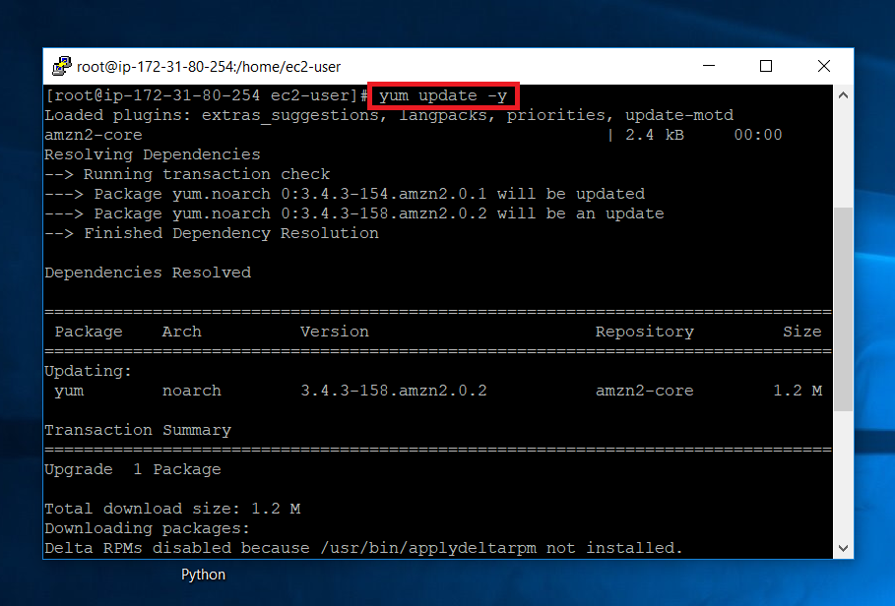
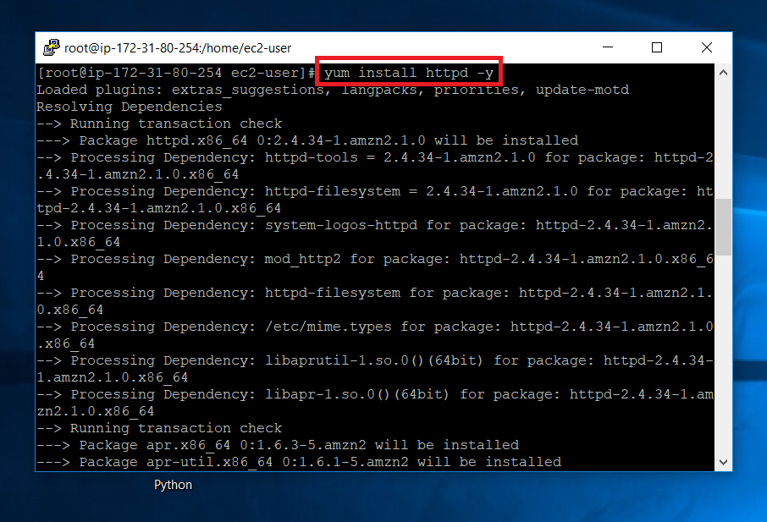
The first command we will use is
yum update –y
yum is a package management tool for RedHat based Linux systems
The update part just updates the Linux Instance we are using
The –y basically is used so that I tell it yes this is what I want. If I did not have –y I would have to tell it yes after it found the package. This is useful if you know what you want installed.
Next we need to install apache using the
yum install httpd –y command
Yum will be used to locate the install
Install will be telling it to install
httpd is the web daemon also known as apache

Slide 20
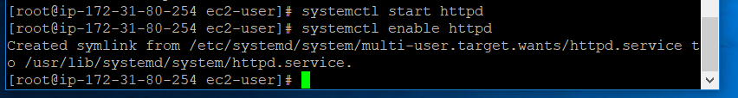
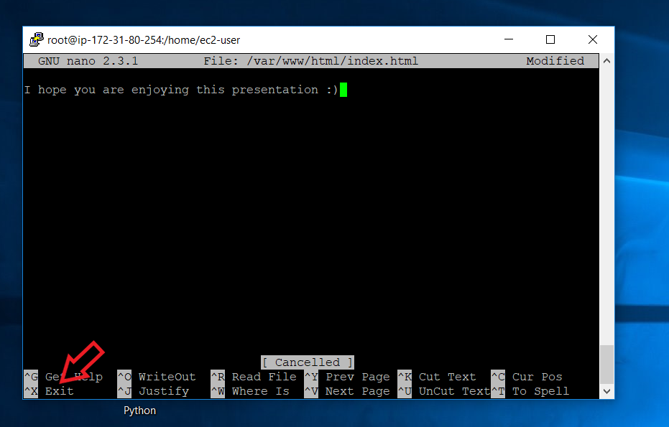
We will need to start and enable the httpd service
Use the systemctl start httpd and systemctl enable httpd
The systemctl command is used to control services
Apache will then be installed and on
To create a website we need to add a text file in the /var/www/html/ folder
Using the nano /var/www/html/index.html command will allow us to do this
Nano is a text editor shown in the bottom picture and in the command we put the path we want and name the file index.html
We will then type in something and save it in that folder

Slide 21
After we save that file we should be able to view our website
We will locate our IP address that we used for SSH and put that in a web browser
Obviously this is almost as basic as a website can get, but it can easily get more advanced by learning PHP scripting which is a scripting language focused for web development

Slide 22
